Slide 1
Big Mountain Ski Resort
Data analysis
and
Recommendations

Slide 2
Problem Statement:
Big Mountain plans on increasing operational costs by $1,500,000 this season and needs to offset this by increased revenues
The ski resort market is competitive and therefore ticket price changes are delicate and need to be fine-tuned
Big Mountain needs to determine how and to what extent different facilities affect supportable ticket prices using a data driven approach
A predictive analysis need to be made on rich ski-resort dataset of different competitors

Slide 3
History
Big Mountain plans on increasing operational costs by $1,500,000 this season and needs to offset this by increased revenues
The ski resort market is competitive and therefore ticket price changes are delicate and need to be fine-tuned
Big Mountain needs to determine how and to what extent different facilities affect supportable ticket prices using a data driven approach

Slide 4
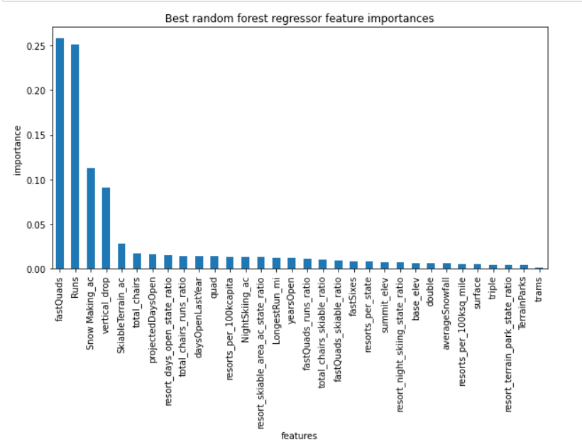
Key Findings:
The most important features are :
Snow Making_ac
total_chairs
fastQuads
Runs
LongestRun_mi
trams
SkiableTerrain_ac
Vertical_drop
Big Mountain is on the upper end for most facilities compared to competitors in the market
Big Mountain is underpricing their tickets by around $10
Increasing the length of the longest run or increasing snow coverage area has minimal impact on revenue

Slide 5
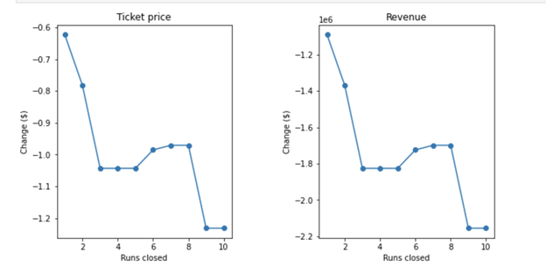
Closing up to 10 Runs vs (Ticket price & Revenue)
Big Mountain Resort has been reviewing a potential scenario for cutting costs by Permanently closing down up to 10 of the least used runs.
Our Model predicted the following when it comes to closing up to 10 used Runs:
Closing one run will have no impact on Ticket price or revenue.
Closing down 3 runs, it seems they may as well close down 4 or 5 as there’s same loss in ticket price and revenue by $0.67 and $1.250M respectively.
Closing 10 runs reduce support for ticket price and so revenue by $1.71 and $3M respectively.
Because we don’t know the operating cost per used run, we can’t determine how much cost saving will be offset the loss in revenue after closing more than one run

Slide 6
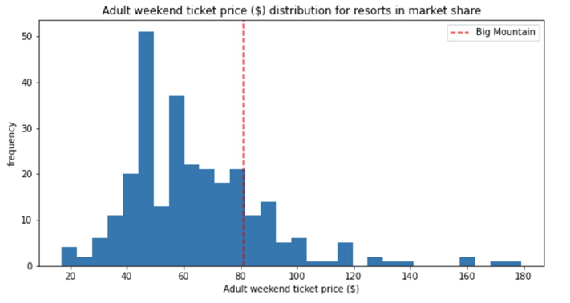
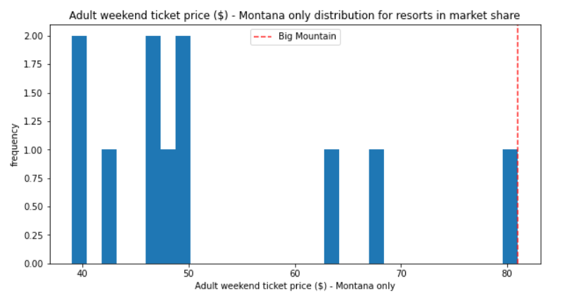
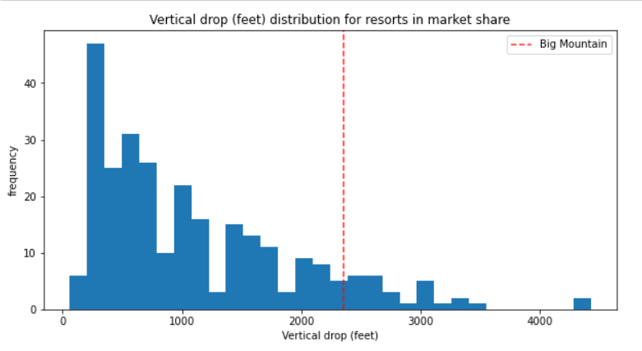
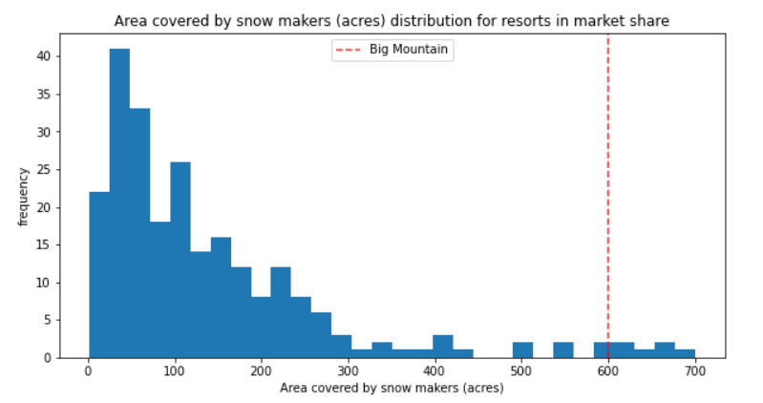
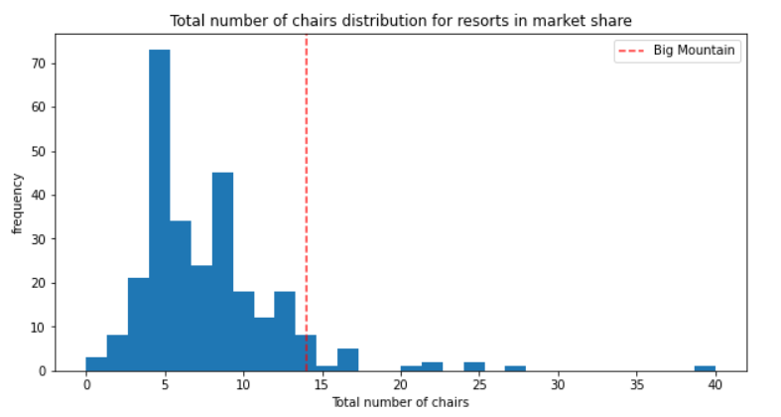
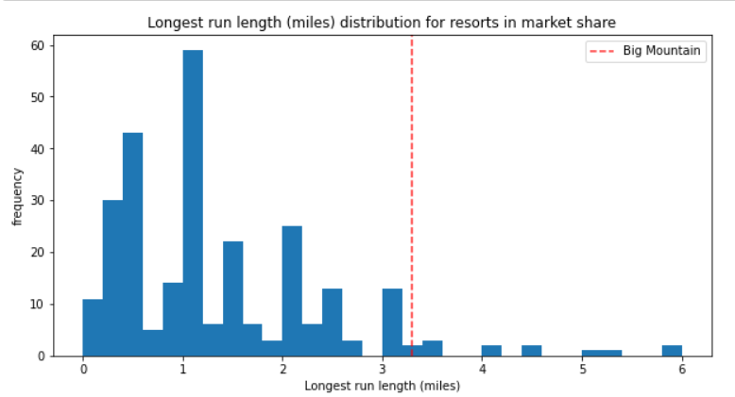
Big Mountain Ticket Price comparison in market

Slide 7
Conclusion
The model suggests that Big Mountain is underpricing their tickets so the company can probably increase prices marginally with a disproportionately smaller penalty
There are only a handful of important facilities that are most relevant to affecting ticket prices, around 8
The company should consider closing down the least used run and enacting Scenario 2
The model’s scope is only the dataset provided so model results should be accompanied by domain knowledge and business knowledge during decision making

Slide 8
Conclusion
The best scenario where we managed to gain the highest revenue increase possible was by -
adding one run and adding
increasing the vertical drop by 150 ft
2 acres of snow making cover
adding one Chair Lift
This scenario has increased ticket price by 12% from $81 to $94.66, resulting in a bottom-line increase by $15,528,841 (After deducting operating costs = $1.54M).
Because of lack of data on operating cost per used run and weekdays ticket price, model cannot recommend closing down used runs.

